Slide 1
DOM

Slide 2
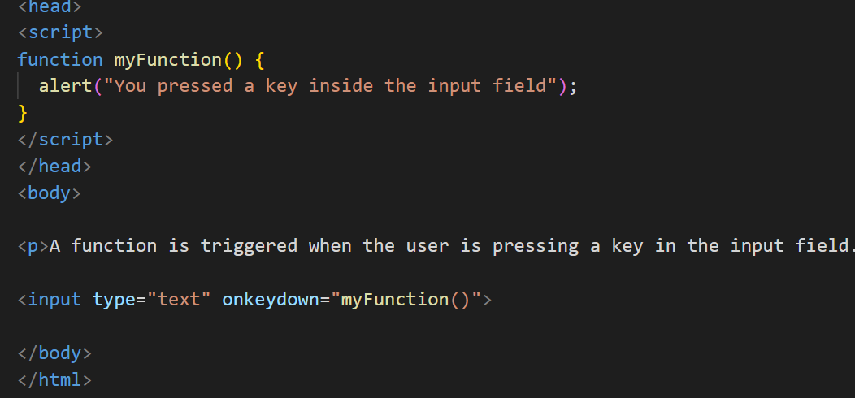
onKeyDown

Slide 3
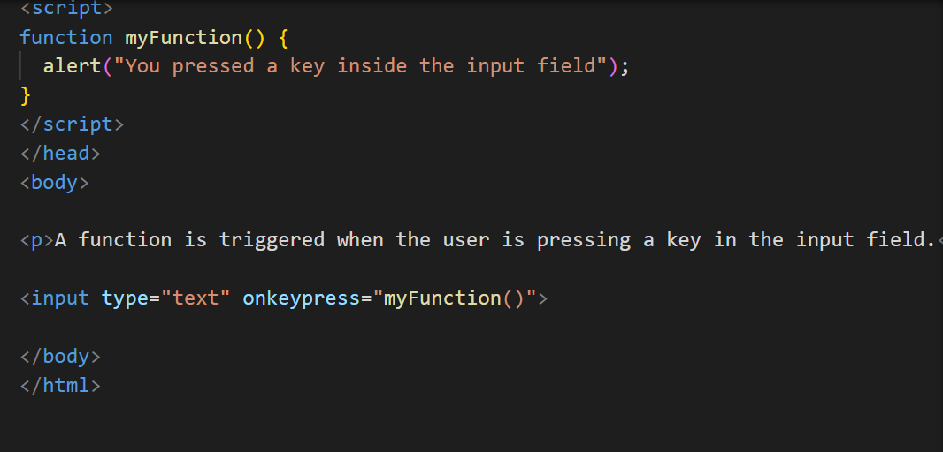
onKeyPress

Slide 4
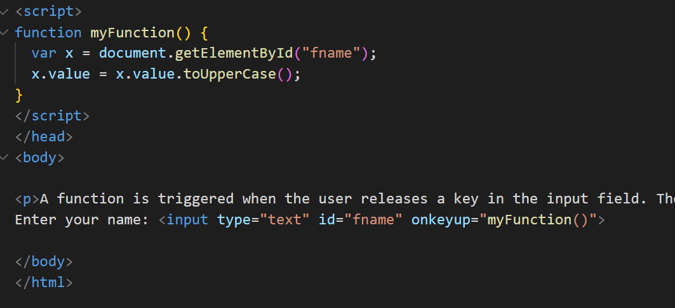
onKeyUp

Slide 5

onKeyUp and onKeyPress

Slide 6
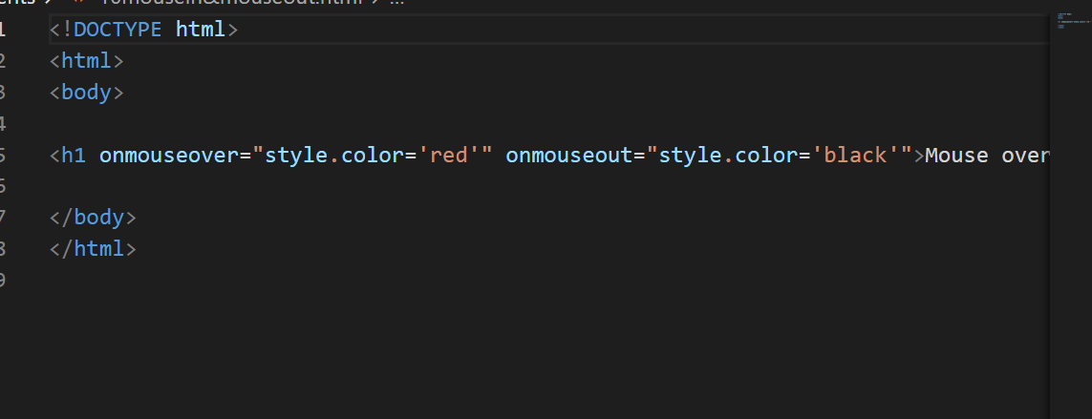
onMouseOver and onMouseOut

Slide 7
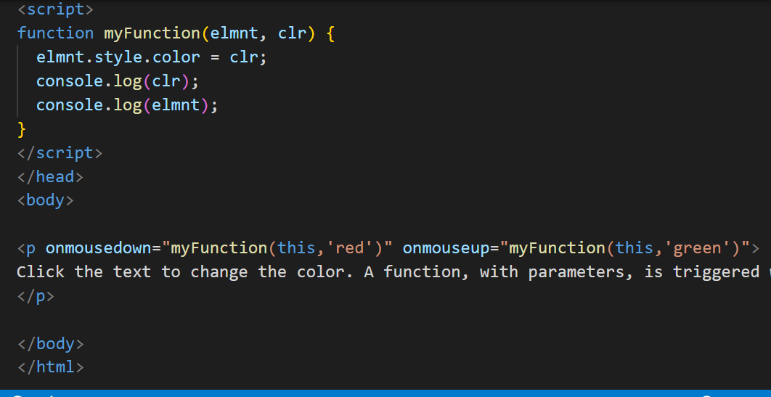
onMouseDown and onMouseUp

Slide 8
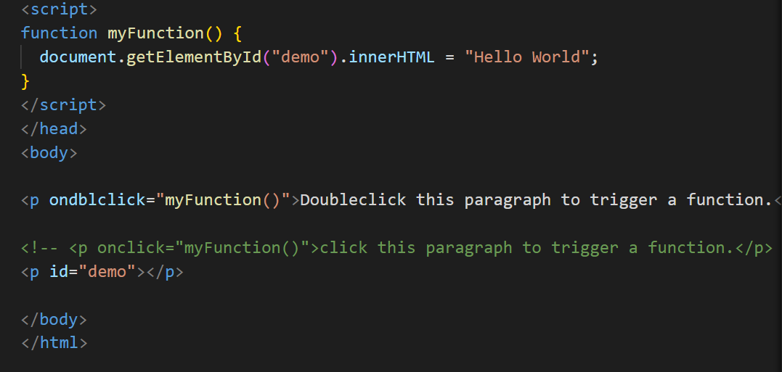
onDoubleClick

Slide 9
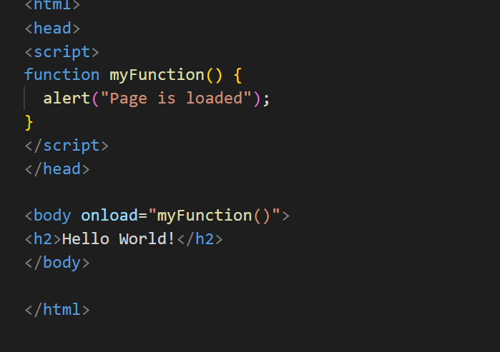
onLoad

Slide 10
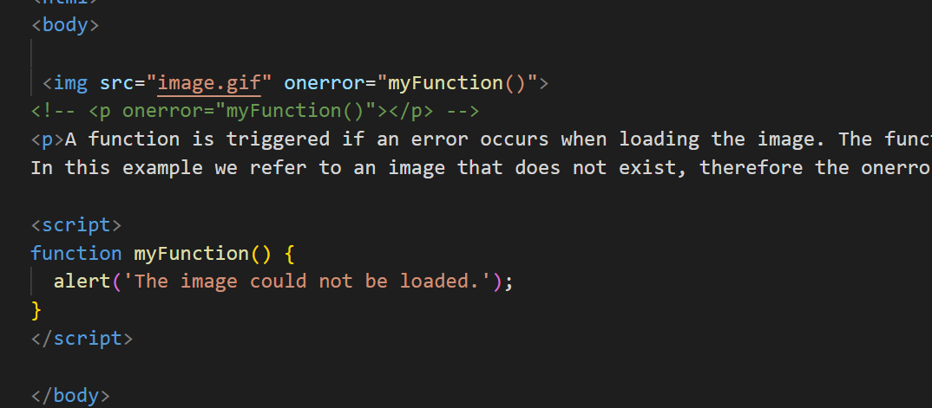
onError

Slide 11
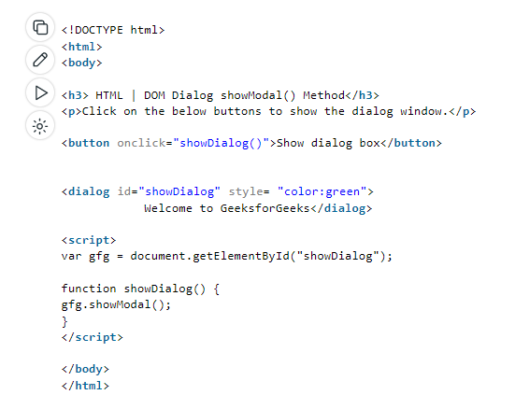
DOM Modal - showModal()

Slide 12
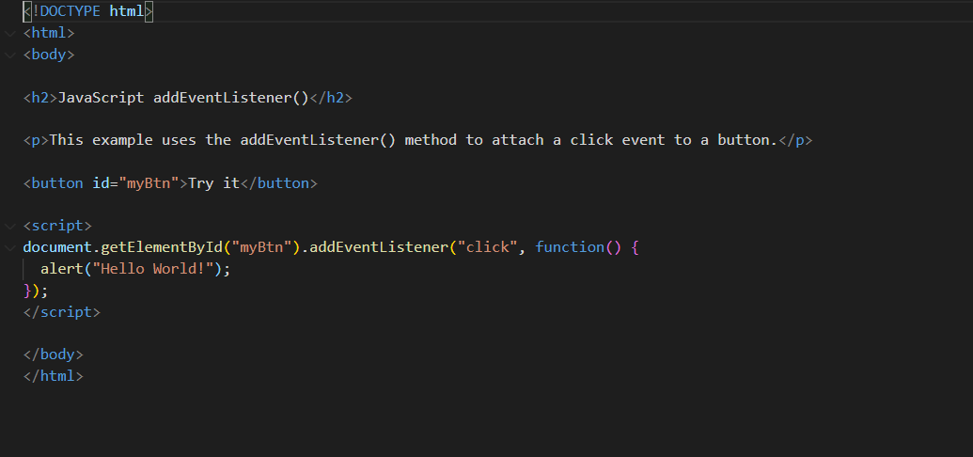
Event Listener

Slide 13
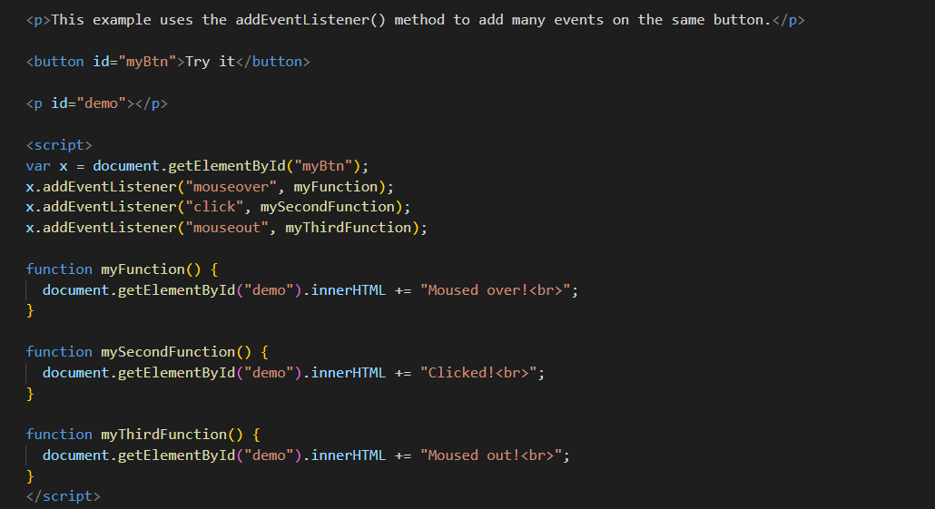
Event Listener

Slide 14
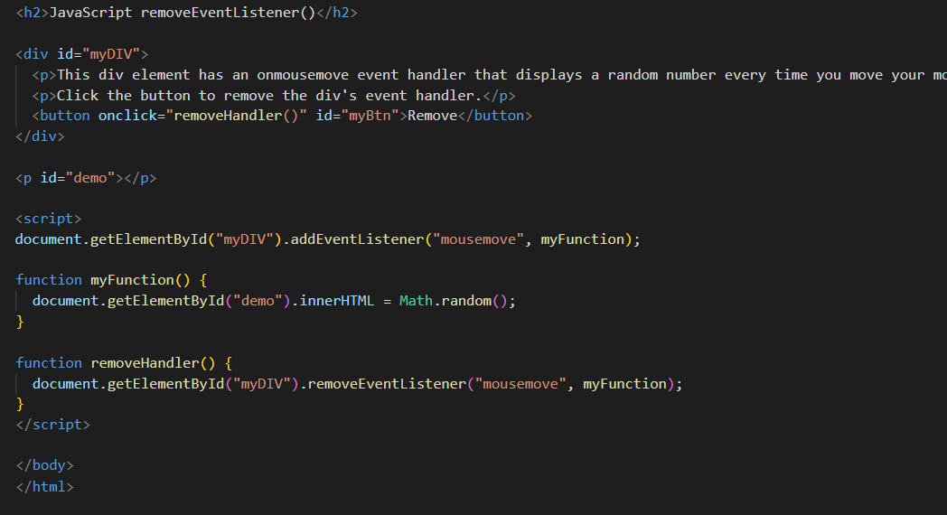
Remove Event Listener

Slide 15
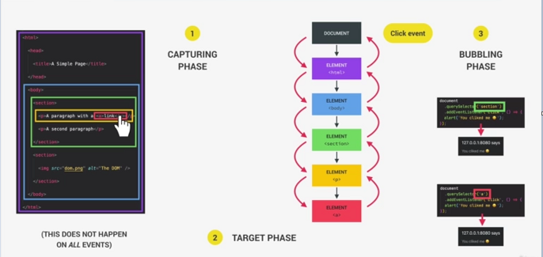
Bubbling and Capturing

Slide 16
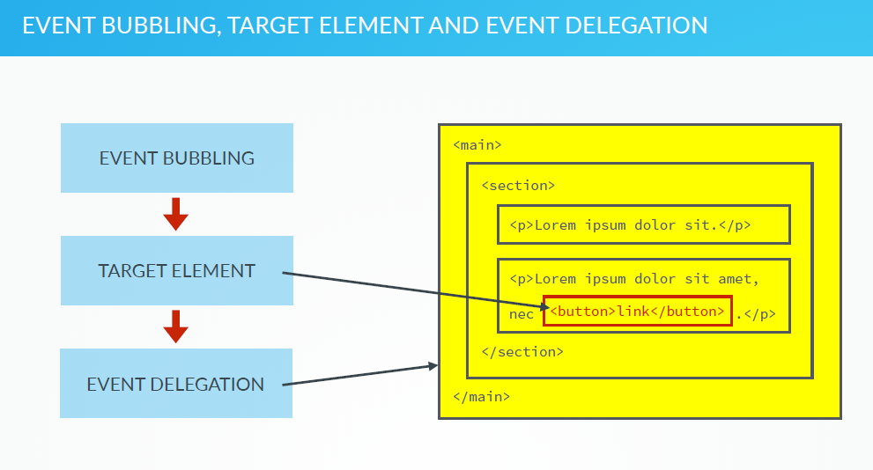

Slide 17
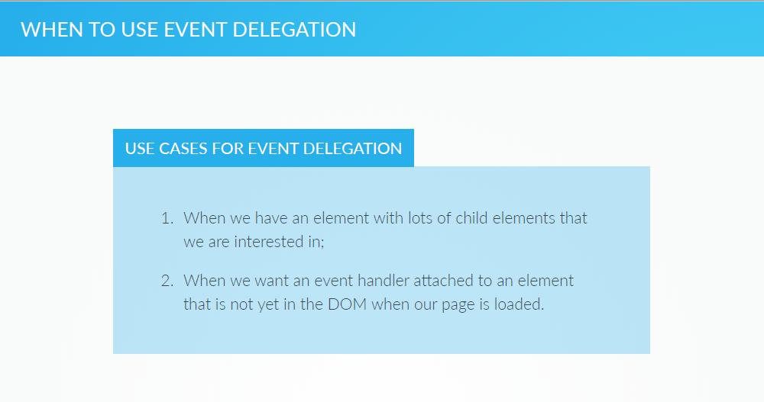

Slide 18
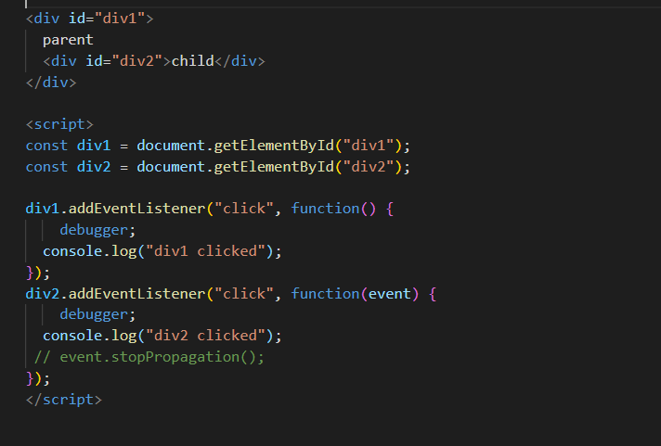
Event Bubbling Example

